Slide 1
Some Elements on Green Budgeting
Fiscal Affairs Department

Slide 2
Outline
Rationale
Integrating the Green Dimension Into the Budget Cycle
How To Implement Green Budgeting Reforms?

Slide 3
Rationale
I

Slide 4
Sound PFM Practices Can Help Achieve Green / Climate Change Commitments.
True for any sectoral policy…
… but climate change is cross-cutting…
… calling for PFM institutions that are more sensitive to it
Assessing more precisely the climate effects of fiscal policies
Designing green fiscal strategies and supporting their implementation
Knowing whether green objectives are on track

Slide 5
Towards Green Budgeting
“Green Budgeting is designed to drive improvements in the alignment of public expenditure and revenue processes with climate and other environmental goals.
It means to systematically examine existing and potential budget measures and policies, their interdependencies, externalities and joint benefits, and to mainstream an environmentally-informed approach into the national and subnational budgetary frameworks.”
(OECD definition)

Slide 6
Green Budgeting Practices Are Still Embryonic in Most Countries.
20% of OECD countries publish the environmental impact of individual budget measures
(source: OECD, 2018).
Only 3 OECD countries integrate climate change across all budget programmes.
(source: OECD, 2018).
Only 25% of countries publish quantitative information about environmental risks
(source: FTE).

Slide 7
Integrating the Green Dimension Into The Budget Cycle
II

Slide 8
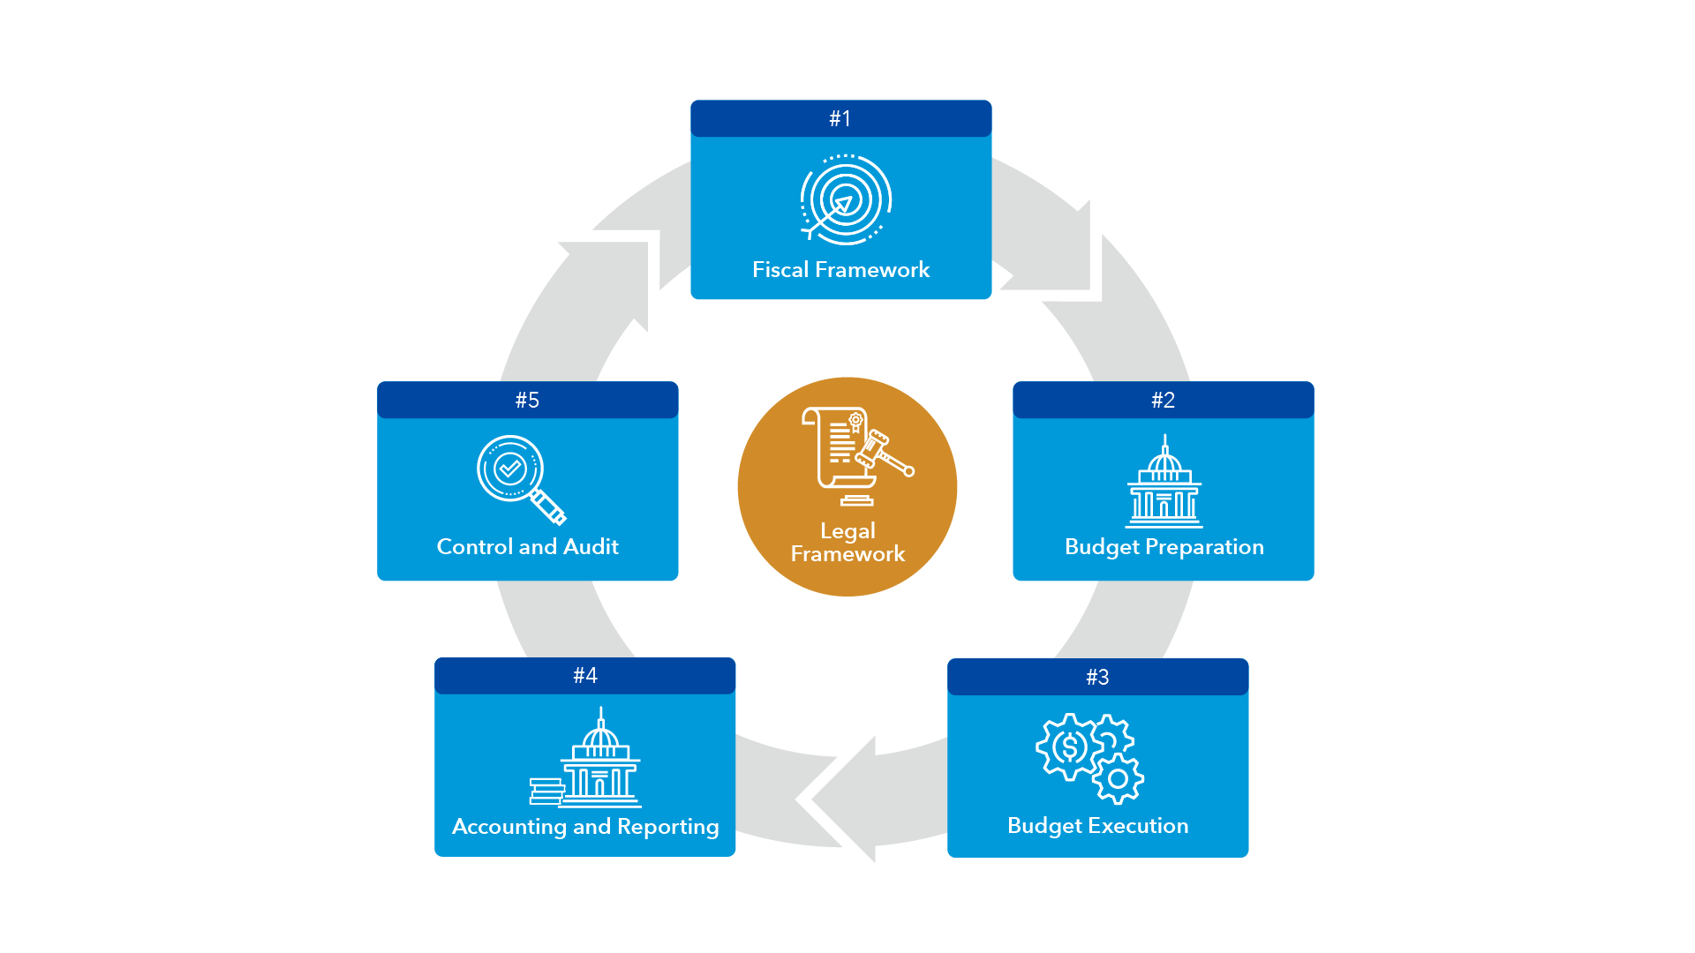
The Budget Cycle

Slide 9
Key Entry Points for Green Budgeting
Environmental objectives and targets in development plans
Greening of medium-term fiscal frameworks and strategies
Management of climate related fiscal risks
Long term fiscal sustainability
Ex ante climate assessments
Program / performance budgeting
Green budget circular
Green budget documentation

Slide 10
Key Entry Points for Green Budgeting
Ex post climate impact evaluations
External audit
Independent climate watchdogs
Green/climate budget tagging
Classification systems
In-year monitoring and reporting
Ex post reporting on green outputs and outcomes

Slide 11
Entry Points for Green Budgeting
Amending existing PFM laws to include green elements
Ex. Mexico, New Zealand
Enacting specific climate action laws
Ex. Philippines, Sweden, France

Slide 12
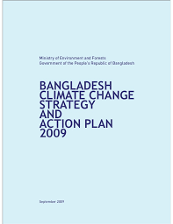
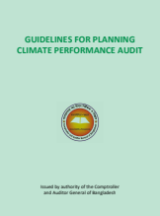
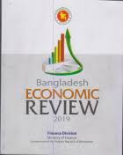
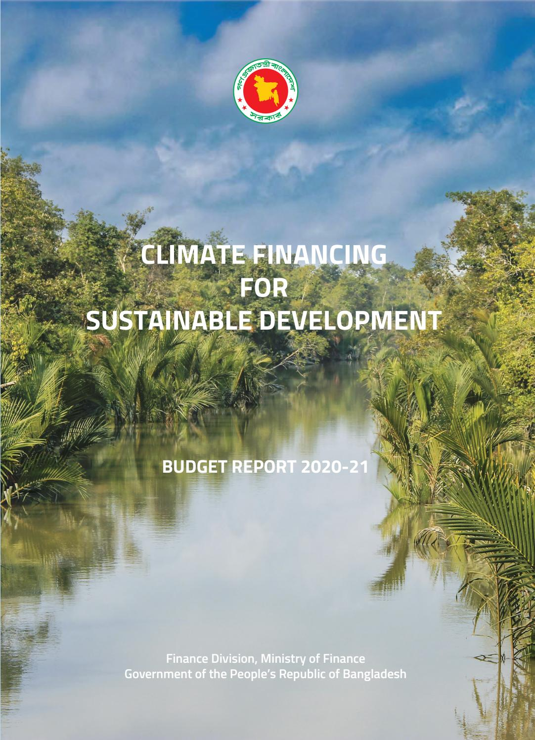
An example: Bangladesh
Climate Change Strategy
Climate Performance Audits performed by the Comptroller and Auditor General
Medium-Term Macroeconomic Framework
Climate-inclusive Budget Circular
Green Elements in Economic Review
Climate Budget Report
Integration in budget classification and FMIS
Climate Budget Tracking

Slide 13
Across And Beyond the Budget Cycle
Relevant Cross-Cutting PFM Areas
Public Investment Management
Fiscal Transparency
Public Participation
Beyond the Budget Cycle
Coordination with subnational governments
Coordination with state-owned enterprises

Slide 14
How To Implement Green Budgeting Reforms?
III

Slide 15
A Few Misconceptions
Treating green budgeting as an end in itself
Considering green budgeting as a reform valid only for advanced economies
Thinking that copying other countries is sufficient
Let’s talk about climate change in the budget circular, and it will all be different!
I have so many other reforms on my plate, and these PFM requirements seem at odds with my level of capacity…
If I get my neighbor country’s recipe for green budgeting reforms, I will apply it to the letter and be successful!

Slide 16
Guiding Principles For Green Budgeting Reforms
Green budgeting reforms should be integrated with existing public financial management reform agendas.
The primary driver for green budgeting reforms should be the Ministry in charge of budget / finance.
Several prerequisites in terms of political ownership and capacity are needed to ensure successful green budgeting reforms.
Governments should look for the smart sequencing of green budgeting reforms.
Communicating on green budgeting reforms is important to ensure buy-in from all stakeholders.

Slide 17
Thank you!

